Slide 1
Carder? I hardly know 'er!
Team Rocket: By Joshua Cain, Nick Arlinghaus, Raj Aware, Jack Butler, Vitta Silberberg

Slide 2
Our Vision
Our project is a Magic: The Gathering card database which a user can use to organize a card collection and trade cards with other users.
Trading card game players/collectors generally accumulate a high volume of cards and may not have a good way of tracking their inventory. This software seeks to alleviate that.
Our approach will be the most user-friendly option available. This product is for the following two user groups:
Trading Card Game Collectors : These are players who want to focus on collecting cards rather than playing with them.
Trading Card Game Players : These players want to play with their cards and want to build their game decks ahead of time.
Both types of players will be able to trade cards with one another.
Alternatives/Competitors: MTGGoldfish Collections, Microsoft Excel

Slide 3
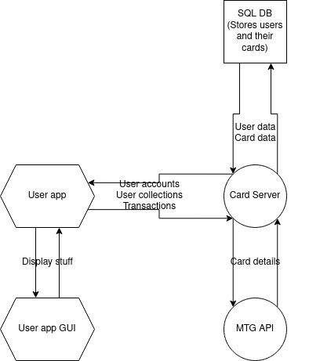
Software Architecture
Python will be used at the core of the software.
A practical, straightforward, and user-focused GUI will be made using the Python Qt module.
The missing data about a user's cards will be filled in using the official Magic: The Gathering API.
Information on each user's card collection will be stored in a MySQL database on the card server.
The multiverseid variable or the id variable, which are unique card identifiers, will be the primary key for the data we store.
We will primarily access card information, including name, set, art, spell type, price, and other details.

Slide 4
Challenges and Risks
The single most challenging aspect of this project is the unfamiliarity some of us have with the game
Difficult to code Magic: The Gathering software having never played the game
Solution: learn about the game first and foremost. Teach each other, maybe play a few rounds.

Slide 5

THANK YOU!

